Slide 1
PROFESSIONAL PORTFOLIO
Dharunkumar R
AI and Automation Engineer

Slide 2
Enterprise Scale Impact
100+
99%
60K+
Production Automations
SLA Breach Reduction
Applications Governed

Slide 3



Core Technical Expertise
Cloud & Identity
Code & Scripting
AI & Automation
Azure, Entra ID (Azure AD), AWS, GCP, Microsoft Graph API.
PowerShell, Python, C#, .NET, SQL, YAML, Playwright.
Power Automate, Azure DevOps, GitHub Copilot, Gen AI.

Slide 4


JAN 2024 – PRESENT
Accenture
Cloud Tech Support Analyst
App Governance Audited 60K+ enterprise applications for security.
CI/CD Frameworks Built reusable PowerShell and Python pipelines.
Tenant Security Multi-tenant SharePoint access scanning.

Slide 5


MAR 2021 – JAN 2024
Tata Consultancy Services
System Engineer
SLA Protection 99% reduction in ServiceNow SLA breaches.
Auto-Tracking Standalone X.509 certificate monitoring.
Data Delivery Automated secure SQL HTML reports.

Slide 6
PROJECT: INFRASTRUCTURE DASHBOARD
100%
Manual RDP capacity checks eliminated.
Centralized utilization telemetry and automated alerts from 50+ servers ahead of failure.

Slide 7

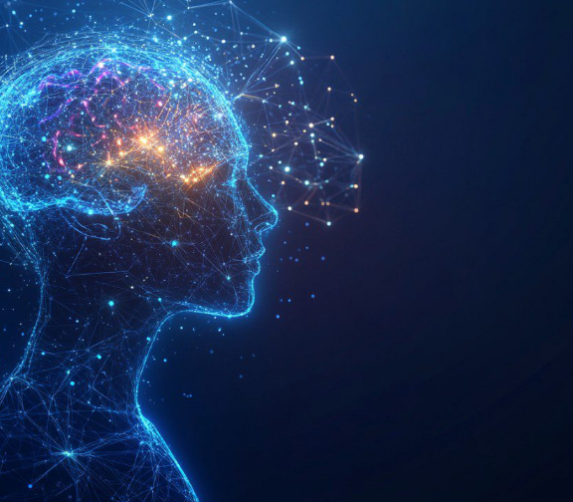
KEY PROJECT
AI-Driven Error Triage
Automated Resolution Analyzes failures and generates suggested fixes.
Generative AI Core Powered by Azure OpenAI small language models.
Cost Efficient Known-error caching keeps running costs near zero.

Slide 8



Certifications & Education
Microsoft Azure Certified
AWS Certified
Developer, Security, Admin, Fundamentals
AI Practitioner
GitHub Foundations
B.E. Electronics & Comm.
Reinvention with Agentic AI
K. Ramakrishnan College of Engineering

Slide 9


Let's Build the Future
Open to impactful roles in AI and Enterprise Automation.
dharunkumarr05@gmail.com
linkedin.com/in/dharunkumar-r-351546179

